Slide 1
READ 634 Final Group Project: 20 Reading & Writing Strategies for ELL Students
Hartley Burget, Danielle Roland, Sara Olsen, Courtney Munger, & Marqui Keim
Notes:
NICE TITLE PAGE

Slide 2
Strategy 1: Multisensory Phonics Instruction
Multisensory phonics requires teachers to use all senses to reinforce learning in the brain
Information should be taught in multiple ways.
Example: say the letter verbally and have the child repeat it. Show the child a picture of the letter and an object that starts with the letter. Connect the picture and name of the letter to the sound it makes and an example of a word with the letter (i.e. a, apple, /a/). Then have the child trace the letter. The most effective way to do this is to have the child use their finger to trace it. You can use a plate and salt and have the child trace the letter in the salt.
Multisensory phonics instruction is the most crucial with young children who are beginning to read.
However, it can also be effectively used with older students who are struggling or are ELL.
Notes:
MULTISENSORY INSTRUCTION EFFECTIVELY ENGAGES THE BRAIN FOR RETENTION.

Slide 3
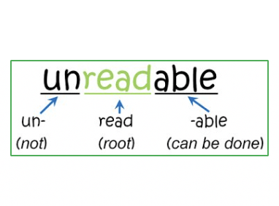
Strategy 2: Utilize and Teach Morphemic Analysis
ELL students often come to us with a good contextual understanding of the language
However, since English is comprised of so many languages, teaching students, especially ELL students, to break up words by their prefix, base, and suffix can help them gain a better understanding of the meaning of unfamiliar words.
Though this can be used with all ages, the level of difficulty will vary.
Example for young elementary students- these students may struggle to break up large words into morphemes but could understand that beautiful means something is full of beauty by understanding that beauty is the base and the suffix –ful means full of.
Example for older students: if a child is unfamiliar with what the word biology means, they can use their understanding of morphemes to break it down. Bio- means life and –ology means the study of. Students can then determine that biology is the study of life.
Notes:
GREAT EXPLANATIONS AS WELL AS MODEL. THANK YOU

Slide 4
Strategy 3: Context Clues
Teaching ELL students to utilize their context clues can help them understand unfamiliar words in a text by using familiar words and sentences around the unfamiliar word to determine the meaning.
Example: Carnivores, or meat-eating animals, typically have sharp front teeth for tearing meat.
In this example, students who are unfamiliar with the word carnivore, can determine that carnivores are meat-eating animals because the clues next to the word tell us that.
Notes:
CONTEXT CLUES/CUES ARE SO IMPORTANT, BUT NEED TO BE KEPT IN PERSPECTIVE AND TEACH STUDENTS HOW IT WORKS AND HOW TO USE IT…WHAT TO LOOK FOR IN THE TEXT SURROUNDING THE QUESTIONABLE VOCABULARY TERM.

Slide 5
Strategy 4: Audiobooks
Utilizing audiobooks with ELL students has many benefits
It allows them to listen to a fluent reader
Can be used to help them gain information for comprehension without having to focus on decoding words
Aids in vocabulary development
These can be replayed to allow for students to go back when needed
Can help with letter-sound correspondences
This strategy can be used with students of all ages
Example: Websites such as Epic have multiple books of various genres and levels. Many of these have the option to be read aloud. Students can follow along while the book is read since the words are highlighted. This helps students be able to get both audio and visual experiences with the story.
Notes:
AUDIO BOOKS ARE EXCELLENT TOOLS K AND UP! THEY CAN MODEL GOOD READING STRATEGIES.

Slide 6
Strategy 5: Verbal and Visual Word Association
Verbal and visual word association can be used throughout the school, classroom, and individual lessons. The strategy simply means giving students the means to associate the language they are learning with the visuals of the words represented.
For example, when students are learning a word like tree, providing students with a picture of a tree allows them to associate the word with its meaning. Verbal and visual word association can include labels on classroom items, pictures with vocabulary, and more.
As students continue learning language, they can create their own personal word associations. For example, if they are learning the idea of love, a student might draw a picture of their family in a heart as their own personal association with the word love.
Verbal and visual word association allows students to see the meaning behind the language they are learning. With a visual in their mind, students are better able to remember the words they are learning.
Notes:
THE FOUR QUADRANTS ARE SO IMPORTANT FOR ASSISTING STUDENT LEARNING AND RETENTION

Slide 7
Strategy 6: Interactive Online Games
Interactive online games are engaging ways for students to learn language.
Students learn language visually and verbally while playing these games. They can connect pictures to words in English.
Examples of interactive games include story generators, vocabulary games, and grammar games.
Online games makes language learning fun when it can often be frustrating.
Resources that have these games include Read Write Think and EAL teaching strategies online.
Online games should not be the entirety of the curriculum, but they can reinforce language learning.
https://www.eyesparks.com/language-games-for-indigenous-languages/
Notes:
THE ONLINE GAMES CERTAINLY ENGAGE STUDENTS!

Slide 8
Strategy 7: Computer Assisted Instruction
Computer Assisted Technology can be useful as a supplemental tool to language learning. It should not be the whole curriculum, but it can reinforce or aid students' language learning.
Computer assisted instruction can provide students with the support and practice they need to better learn a language. Computer assisted technology is often used with older ELL students as it can make language learning more fun.
Examples of CAI include computer books, vocabulary practice, and writing on a computer. Computer books or interactive stories help students associate words with pictures. Vocabulary can offer visual and verbal associations on a computer and writing skills can be developed while writing on a computer through the use of grammar corrections and immediate feedback. Interactive stories can make reading more fun because it includes music, pictures, voices, and sound effects.
Notes:
CAI CAN CERTAINLY ASSIST STUDENT LEARNING AND REINFORCE RETENTION

Slide 9
Strategy 8: First Language First
First language first is a strategy that allows students to brainstorm and draft their responses in their first language first before they rewrite it in English.
First language first helps ELL students' processing skills as they can simply write their thoughts or answers without having to try to process it in English.
First language first allows teachers to see their ELL students' processing skills without the interference of a language barrier.
An example of using the first language first strategy would be allowing a student to write their first draft of an essay in their first language then redrafting their thoughts into English. This example helps reinforce the importance of drafting as well!
This strategy gives students the skill of translating their first language into English, which can be useful inside and outside the classroom.
First language first allows ELL students to see the importance of their first language. Often, ELL students are asked to forget their first language in favor of English as if their first language is not as good, but first language first helps them maintain their first language while gaining the skill of translation.
First language first allows students to connect ideas in their first language to what they sound like in English. Through redrafting their writing into English, they connect their first language to the English interpretation!
Notes:
THIS MAKES SO MUCH SENSE. WHEN STUDENTS HAVE A STRONG BASE FROM WHICH TO WORK, IT MAKES ALL THE DIFFERENCE AS THEY MOVE INTO LEARNING A NEW LANGUAGE!

Slide 10
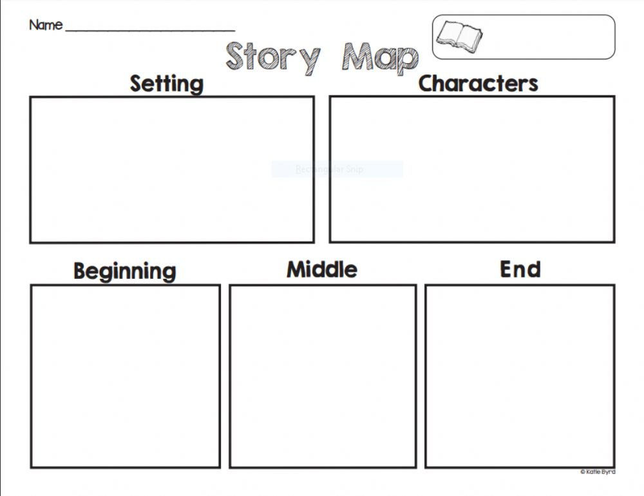
Strategy 9: Graphic Organizers
Graphic Organizer Options
KWL Charts
Venn Diagrams
Story Maps
Timelines
ELL students can benefit from the use of graphic organizers. Graphic organizers help students break down a text or story and see every component closely. Graphic organizers provide a way for students to show their understanding and create connections. Teachers can use graphic organizers to assess for understanding.
Graphic organizers can be used with any age of student.
Graphic organizers can be used during regular instruction in all subjects and in interventions.
Notes:
GRAPHIC ORGANIZERS ROCK! THERE ARE MULTIPLE FORMATS, BUT WHEN STUDENTS HAVE THE OPPORTUNITY TO CHOOSE WHAT WORKS FOR THEM, IT MAKES ALL THE DIFFERENCE!

Slide 11
Strategy 10: Build Background Knowledge
Introduce reading materials that are culturally relevant to students and that they can make connections to.
Connect readings and topics that relate to student's backgrounds and experiences.
Build students background knowledge by using photos, models, videos, picture books, virtual field trips, art, music, etc.
Before writing activate background knowledge by having conversations with students.
Select and teach vocabulary that might be difficult or important.
The following link gives suggestions on how teachers can access student background knowledge. Accessing Students' Background Knowledge in the ELL CLassroom
Notes:
SCHEMA MAKES ALL THE DIFFERENCE!

Slide 12
References
Bean, T. W., Readence, J. E., & Dunkerly-Bean, J. (2019). Content area literacy: An integrated approach (11th ed.). Kendall Hunt.
Cox, C. (2020). Journal Writing. Reading Rockets. https://www.readingrockets.org/article/journal-writing.
Cleaver, S. (2018) What is a book talk?: Your guide to making them work in the classroom. We Are Teachers. https://www.weareteachers.com/what-is-a-book-talk/.
Gillingham, A., & Stillman, B. W. (2004). The Gillingham manual: Remedial training for students with specific disability in reading, spelling, and penmanship. Educators Publ. Service.
Sousa, D. A. (2011). How the ELL brain learns. Corwin Press.
Ybarra, R., & Green, T. (2003). Using technology to help ESL/EFL students develop language skills. The Internet TESL Journal, IX(3).
Notes:
SARA, DANIELLE, HARTLEY, COURTNEY, AND MARQUI, THE STRATEGIES YOU INCLUDED ARE TIME-HONORED AND EFFECTIVE! YOUR STUDENTS WILL ENJOY THEM, TOO!
NICE WORK! ANN PETERSEN

